Slide 1
Verifying cyber-physical systems
chapter 4 - 5
Abenezer Taye
Graduate Research Assistant @ IASL
Date: Mar 23, 2022

Slide 2

Chapter 4: Modeling Cyber-Physical Systems

Slide 3

Introduction
Cyber Physical System (CPS): physical systems that are controlled by computer
Physical system modeling: ordinary differential equations (ODE)
Computer operation: Automata
CPS: ODE + Automata (Hybrid Automata)

Slide 4
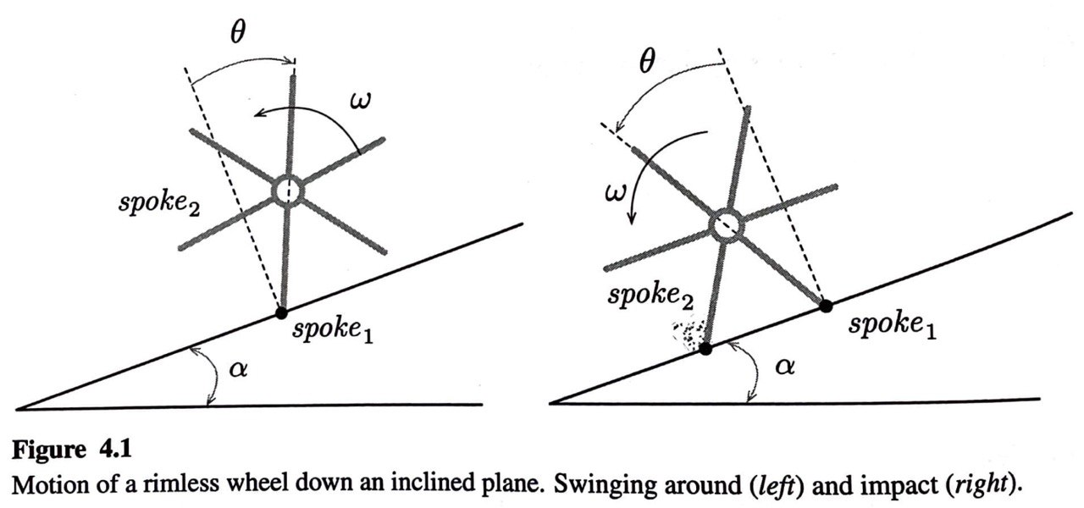
Hybrid automata (HA)
Why study HA?
When the two modeling paradigms collide → strange behavior occurs
It is possible for a HA to perform infinitely many transitions in finite time
It is possible for a HA to become unstable even though its ODEs are stable
Example: Rimless wheel
State change
Instantaneously → during impact & Continuously → over an interval of time

Slide 5
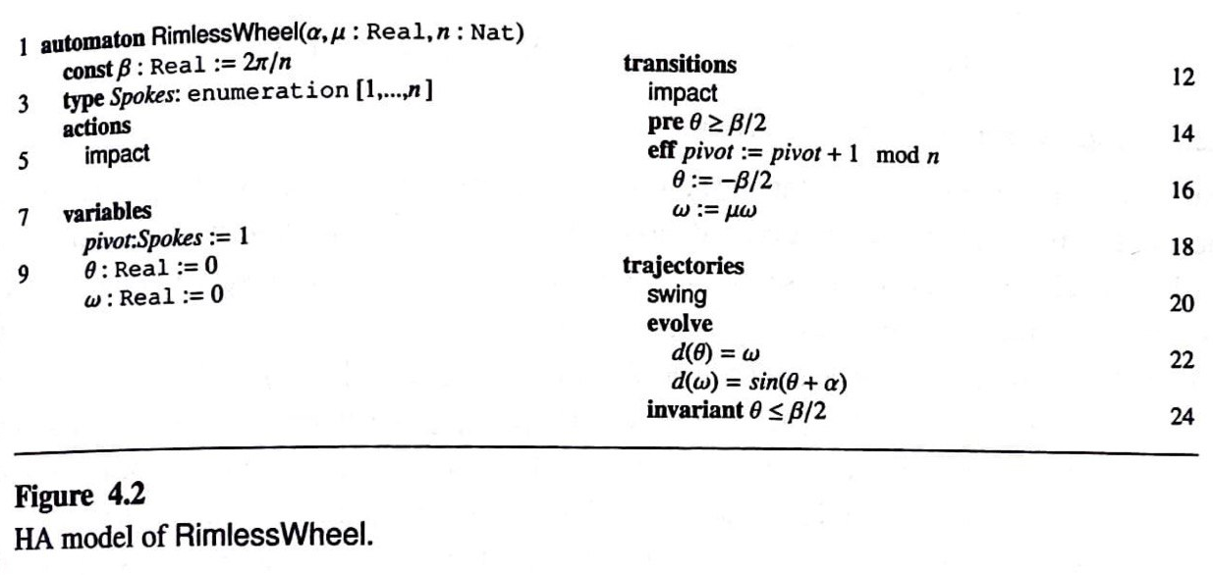
Language for specifying hybrid systems
Actions: lists the actions of the automaton (only impact in this case)
Variables: lists the state variables with their initial conditions
Transitions: describes how discrete variables change
Trajectories: describes how continuous variables change

Slide 6
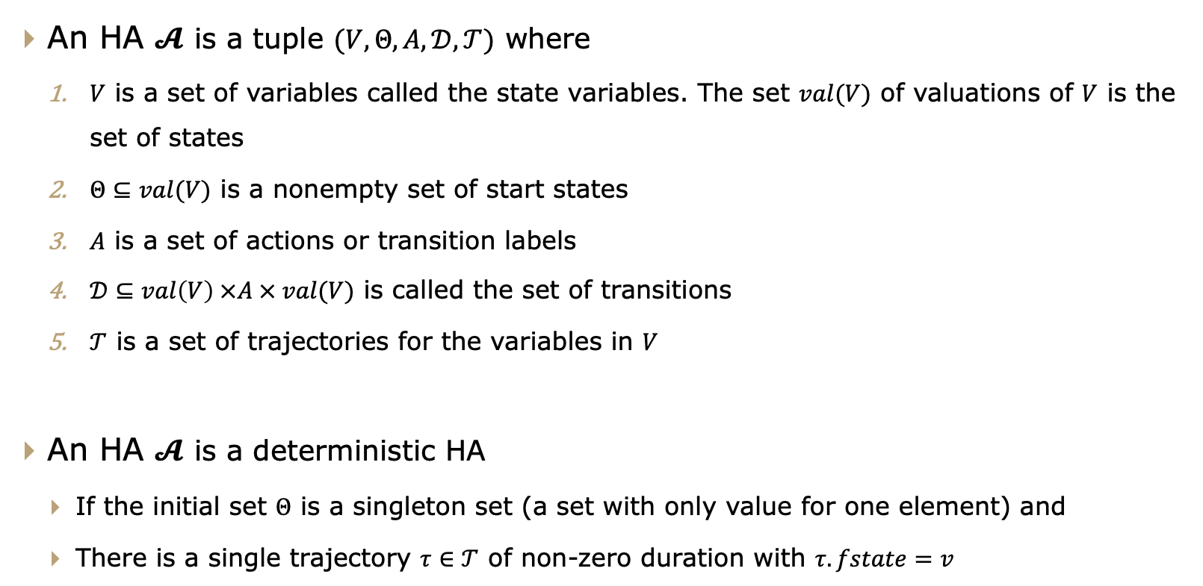
Hybrid automata (HA)
An HA $𝓐$ is a tuple $(V, Θ, A,𝒟,𝒯)$ where
$V$ is a set of variables called the state variables. The set $val(V)$ of valuations of $V$ is the set of states
$Θ⊆val(V)$ is a nonempty set of start states
$A$ is a set of actions or transition labels
$𝒟⊆val\left(V\right) ×A × val(V)$ is called the set of transitions
$𝒯$ is a set of trajectories for the variables in $V$
An HA $𝓐$ is a deterministic HA
If the initial set $Θ$ is a singleton set (a set with only value for one element) and
There is a single trajectory $τ∈𝒯$ of non-zero duration with $τ.fstate=v$

Slide 7
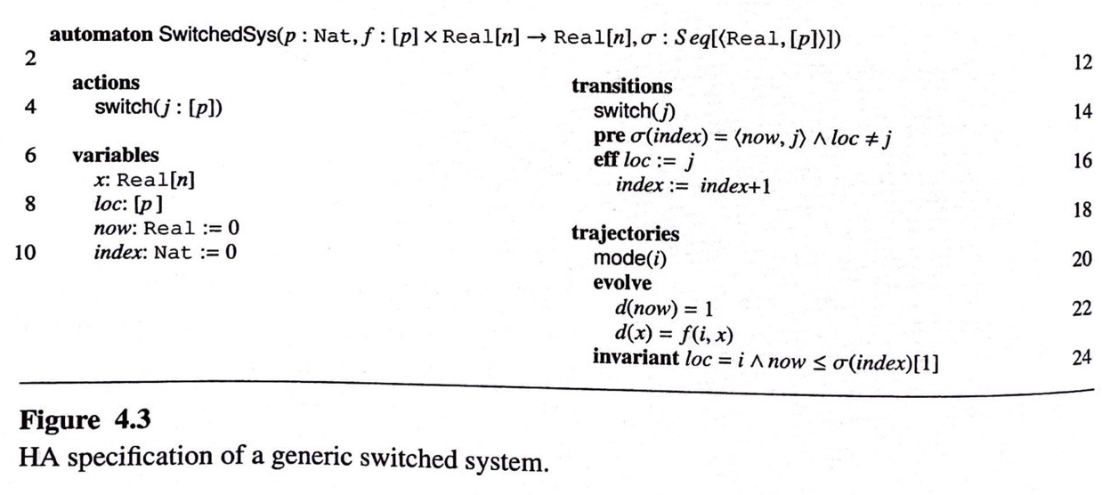

Special classes of Hybrid automata (HA)
Switched systems
It is an alternative formalism for describing cyber physical systems
Describes the system using a set of ODEs → one for each mode
$$\dot{x}=f_{i}\left(x\right), i∈\left[p\right], and p ∈ℕ modes$$
$$\dot{x}=f_{σ(t)}\left(x\right), σ:ℝ_{≥0}→\left[p\right] is swithing signal$$

Slide 8
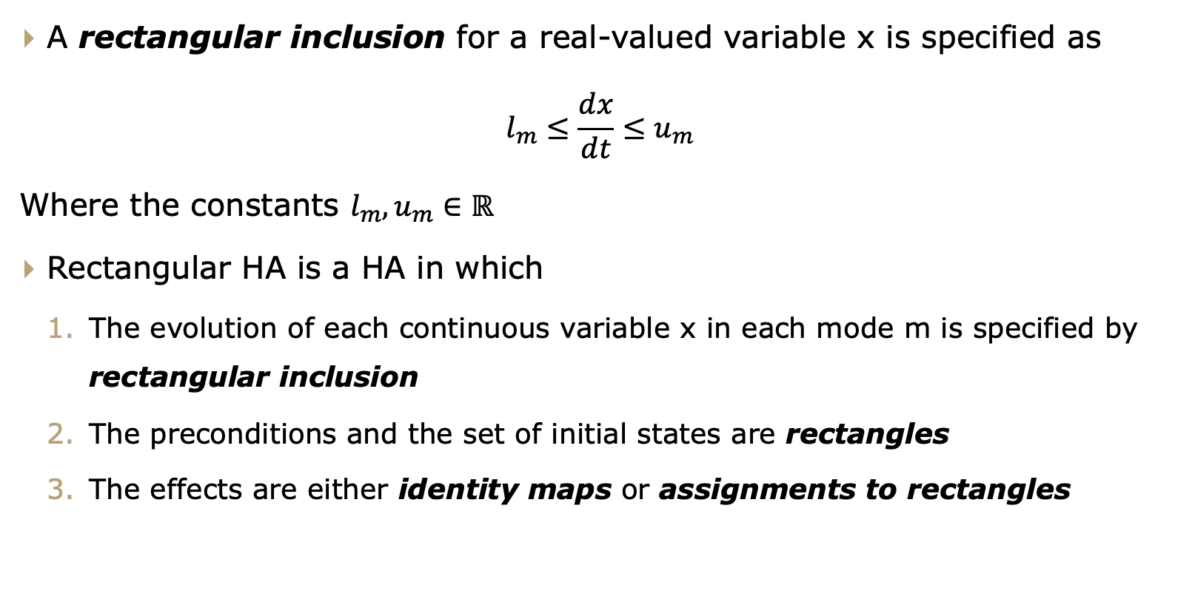
Special classes of Hybrid automata (HA)
Rectangular hybrid automata (RHA)
A rectangular inclusion for a real-valued variable x is specified as
$$l_{m}≤\frac{dx}{dt}≤u_{m}$$
Where the constants $l_{m}, u_{m}∈ℝ$
Rectangular HA is a HA in which
The evolution of each continuous variable x in each mode m is specified by rectangular inclusion
The preconditions and the set of initial states are rectangles
The effects are either identity maps or assignments to rectangles

Slide 9
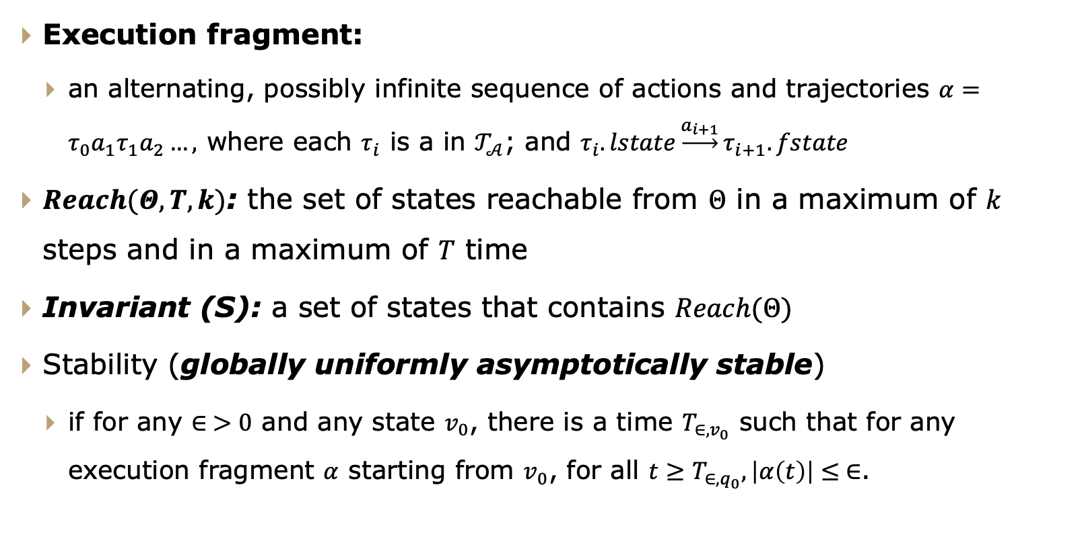
Semantics for Hybrid systems
Hybrid automata (HA)
Execution fragment:
an alternating, possibly infinite sequence of actions and trajectories $α=τ_{0}a_{1}τ_{1}a_{2}…,$ where each $τ_{i}$ is a in $𝒯_{𝒜}$; and $τ_{i}.lstate\underset{→}{a_{i+1}}τ_{i+1}.fstate$
$Reach(Θ,T,k)$: the set of states reachable from $Θ$ in a maximum of $k$ steps and in a maximum of $T$ time
Invariant (S): a set of states that contains $Reach(Θ)$
Stability (globally uniformly asymptotically stable)
if for any $∈ >0$ and any state $v_{0}$, there is a time $T_{∈,v_{0}}$ such that for any execution fragment $α$ starting from $v_{0}$, for all $t≥T_{∈,q_{0}},\left|α\left(t\right)\right|≤ ∈$.

Slide 10
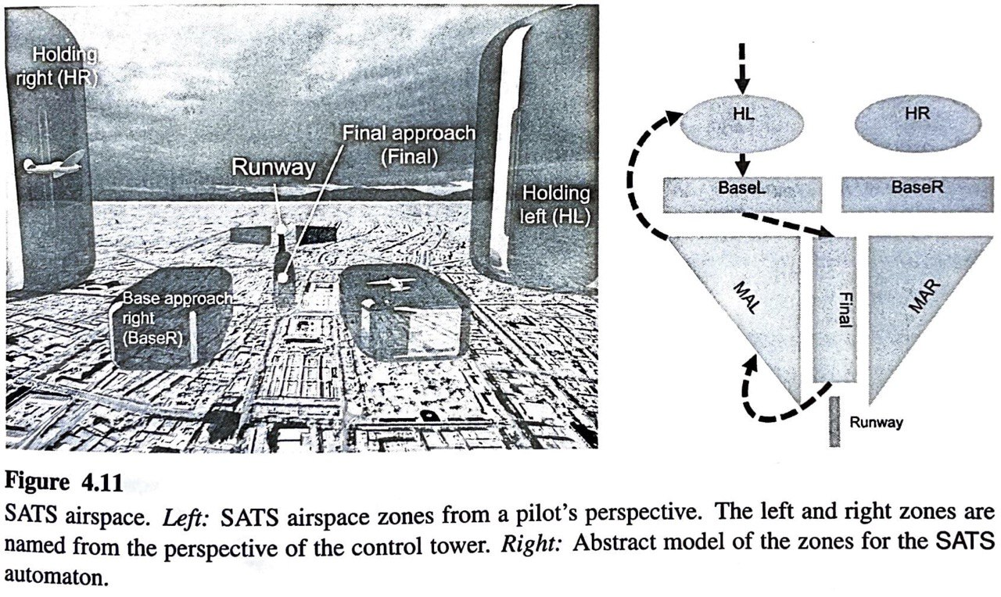
Small aircraft traffic management system
Developed at NASA → to coordinate landing sequence of aircraft with light-weight ground infrastructure
The abstraction captures the distributed coordination across aircraft and the time that it takes for aircraft to clear certain separation requirements
Modeling assumption:
The airspace around the airport is divided into several holding and approach zones
The SATS protocol defines the conditions under which an aircraft participating in the protocol can move from one zone to the next zone
For easier analysis each aircraft → 1D point
Transitions → moving from one zone to another
Trajectories → motion in each zone

Slide 11
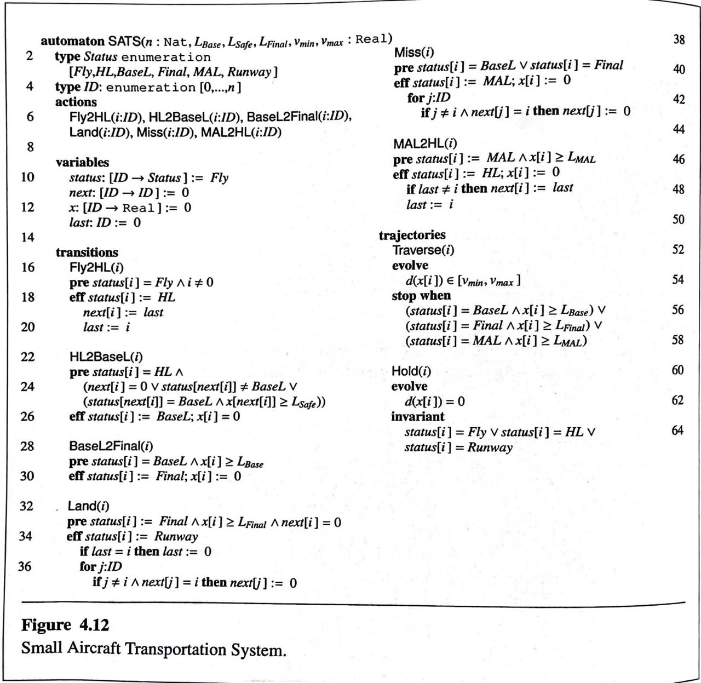
Small aircraft traffic management system

Slide 12
Chapter 5: Composing models

Slide 13
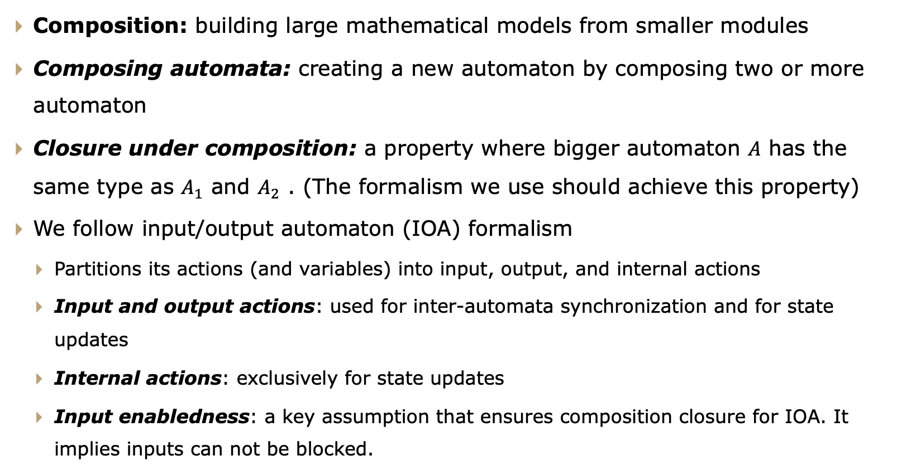
Composing models
Composition
Composition: building large mathematical models from smaller modules
Composing automata: creating a new automaton by composing two or more automaton
Closure under composition: a property where bigger automaton $A$ has the same type as $A_{1}$ and $A_{2}$ . (The formalism we use should achieve this property)
We follow input/output automaton (IOA) formalism
Partitions its actions (and variables) into input, output, and internal actions
Input and output actions: used for inter-automata synchronization and for state updates
Internal actions: exclusively for state updates
Input enabledness: a key assumption that ensures composition closure for IOA. It implies inputs can not be blocked.

Slide 14
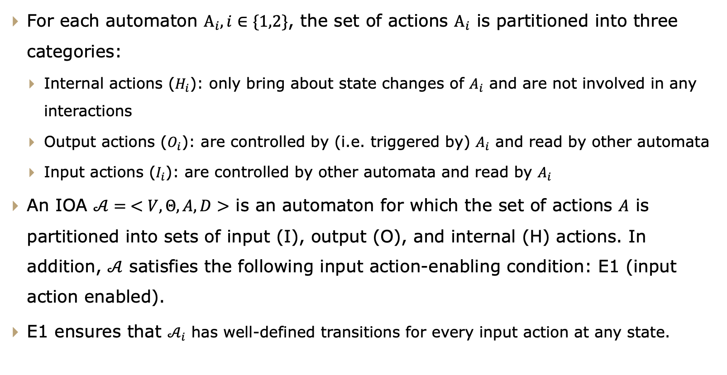
Composing models
Composing input/output automata
For each automaton $Α_{i}, i∈\{1,2\}$, the set of actions $Α_{i}$ is partitioned into three categories:
Internal actions ($H_{i}$): only bring about state changes of $A_{i}$ and are not involved in any interactions
Output actions ($O_{i}$): are controlled by (i.e. triggered by) $A_{i}$ and read by other automata
Input actions ($I_{i}$): are controlled by other automata and read by $A_{i}$
An IOA $𝒜= <V,Θ,A,D>$ is an automaton for which the set of actions $A$ is partitioned into sets of input (I), output (O), and internal (H) actions. In addition, $𝒜$ satisfies the following input action-enabling condition: E1 (input action enabled).
E1 ensures that $𝒜_{i}$ has well-defined transitions for every input action at any state.

Slide 15
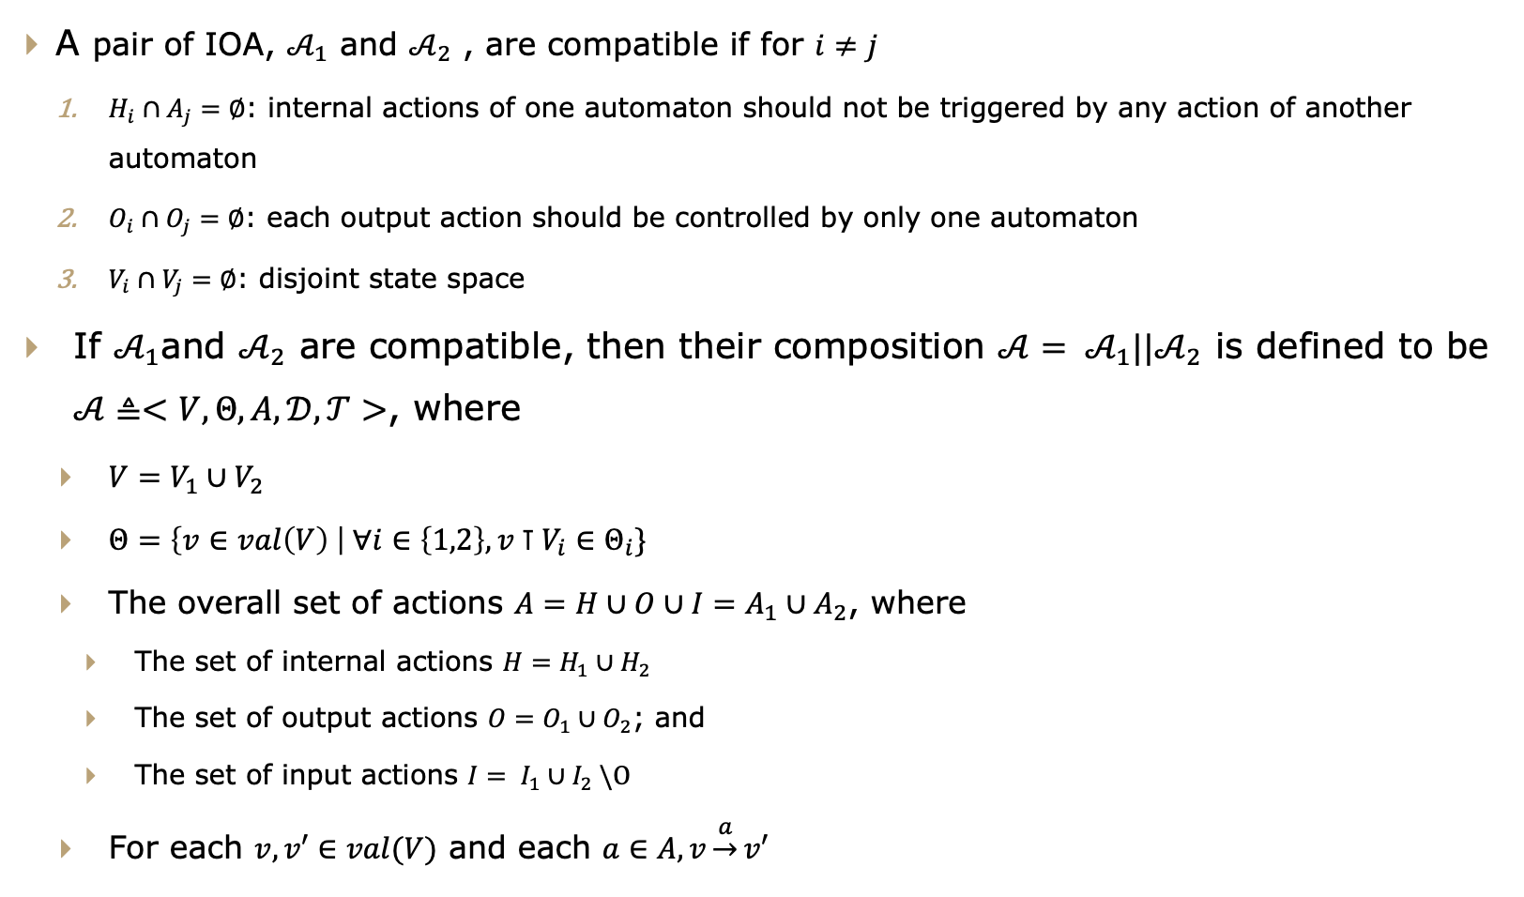
Composing models
Compatibility and composition of IOA
A pair of IOA, $𝒜_{1}$ and $𝒜_{2}$ , are compatible if for $i≠j$
$H_{i}∩A_{j}=∅$: internal actions of one automaton should not be triggered by any action of another automaton
$O_{i}∩O_{j}=∅$: each output action should be controlled by only one automaton
$V_{i}∩V_{j}=∅$: disjoint state space
If $𝒜_{1}$and $𝒜_{2}$ are compatible, then their composition $𝒜= 𝒜_{1}||𝒜_{2}$ is defined to be $𝒜≜<V,Θ,A,𝒟,𝒯>$, where
$V=V_{1}∪V_{2}$
$Θ=\left\{v∈val\left(V\right) \right| ∀i∈\left\{1,2\right\}, v⊺V_{i}∈Θ_{i}\}$
The overall set of actions $A=H∪O∪I=A_{1}∪A_{2}$, where
The set of internal actions $H=H_{1}∪H_{2}$
The set of output actions $O=O_{1}∪O_{2}$; and
The set of input actions $I= I_{1}∪I_{2} \backslash O$
For each $v,v′∈val(V)$ and each $a∈A, v\underset{→}{a}v′$

Slide 16
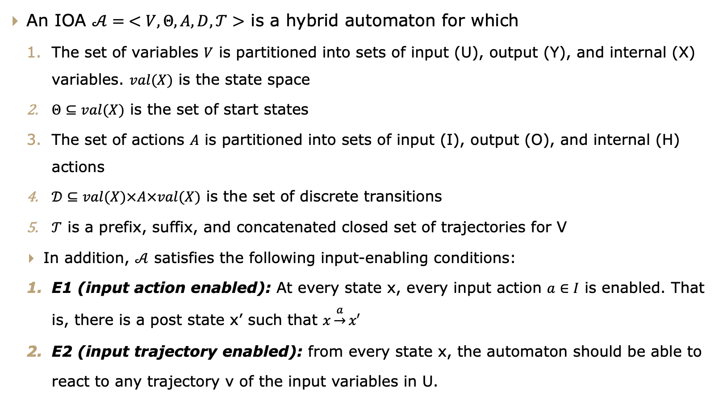
Composing models
Composing hybrid IOA
An IOA $𝒜= <V,Θ,A,D,𝒯>$ is a hybrid automaton for which
The set of variables $V$ is partitioned into sets of input (U), output (Y), and internal (X) variables. $val(X)$ is the state space
$Θ⊆val(X)$ is the set of start states
The set of actions $A$ is partitioned into sets of input (I), output (O), and internal (H) actions
$𝒟⊆val(X)×A×val(X)$ is the set of discrete transitions
$𝒯$ is a prefix, suffix, and concatenated closed set of trajectories for V
In addition, $𝒜$ satisfies the following input-enabling conditions:
E1 (input action enabled): At every state x, every input action $a∈I$ is enabled. That is, there is a post state x’ such that $x\underset{→}{a}x′$
E2 (input trajectory enabled): from every state x, the automaton should be able to react to any trajectory v of the input variables in U.

Slide 17
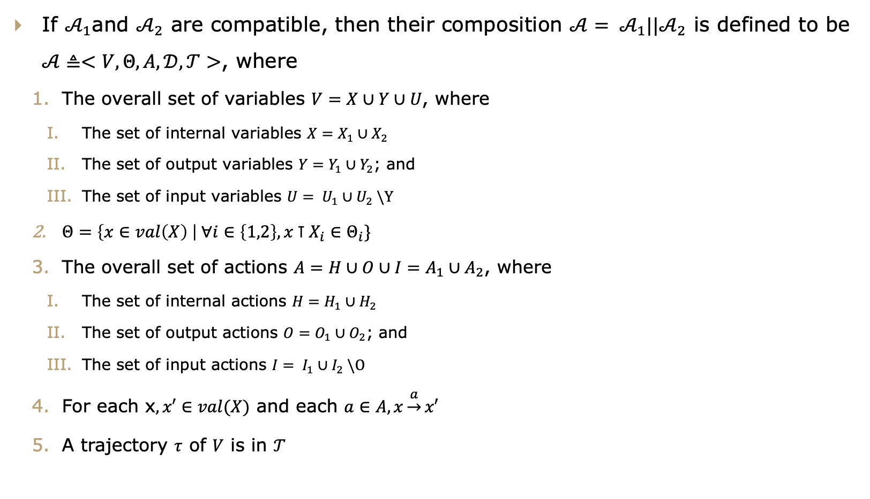
Composing models
Compatibility and composition of HIOA
If $𝒜_{1}$and $𝒜_{2}$ are compatible, then their composition $𝒜= 𝒜_{1}||𝒜_{2}$ is defined to be $𝒜≜<V,Θ,A,𝒟,𝒯>$, where
$\text{The} \text{overall} \text{set} \text{of} \text{variables} V=X∪Y∪U\text{, }\text{where}$
$\text{The} \text{set} \text{of} \text{internal} \text{variables} X=X_{1}∪X_{2}$
$\text{The} \text{set} \text{of} \text{output} \text{variables} Y=Y_{1}∪Y_{2}\text{; }\text{and}$
$\text{The} \text{set} \text{of} \text{input} \text{variables} U= U_{1}∪U_{2} \backslash Y$
$Θ=\left\{x∈val\left(X\right) \right| ∀i∈\left\{1,2\right\}, x⊺X_{i}∈Θ_{i}\}$
The overall set of actions $A=H∪O∪I=A_{1}∪A_{2}$, where
The set of internal actions $H=H_{1}∪H_{2}$
The set of output actions $O=O_{1}∪O_{2}$; and
The set of input actions $I= I_{1}∪I_{2} \backslash O$
For each x$,x′∈val(X)$ and each $a∈A, x\underset{→}{a}x′$
A trajectory $τ$ of $V$ is in $𝒯$

Slide 18
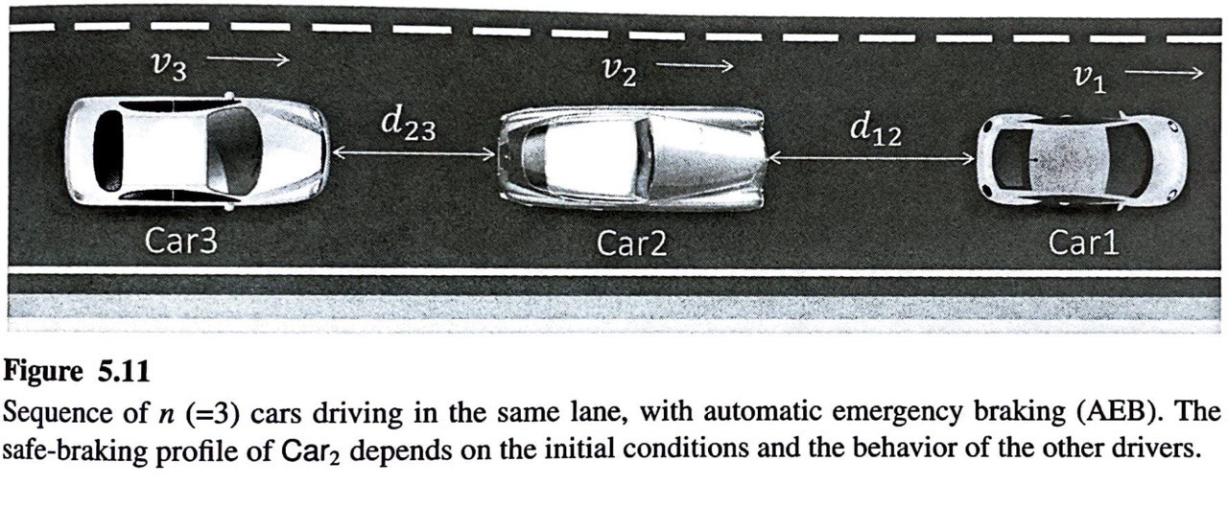
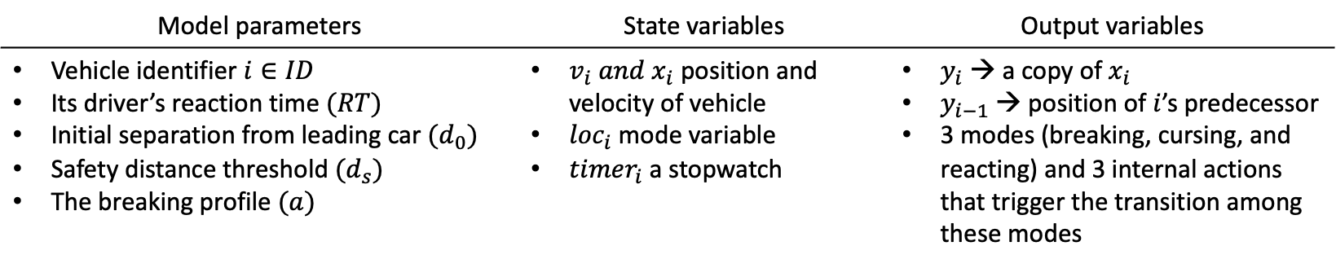
Advanced Driver assistance system (ADAS)
More than 25% of reported traffic accidents are rear-end crashes
85% of which happens on straight road
Emergency breaking intervene automatically and prevent this type of accident
Developed a HIOA to facilitate the testing of such system
Model parameters | State variables | Output variables
Vehicle identifier $i∈ID$ Its driver’s reaction time $(RT)$ Initial separation from leading car ${(d}_{0})$ Safety distance threshold ${(d}_{s})$ The breaking profile $(a)$ | $v_{i} and x_{i}$ position and velocity of vehicle ${loc}_{i}$mode variable ${timer}_{i}$a stopwatch | $y_{i}$→ a copy of $x_{i}$ $y_{i−1}$→ position of $i$’s predecessor 3 modes (breaking, cursing, and reacting) and 3 internal actions that trigger the transition among these modes

Slide 19
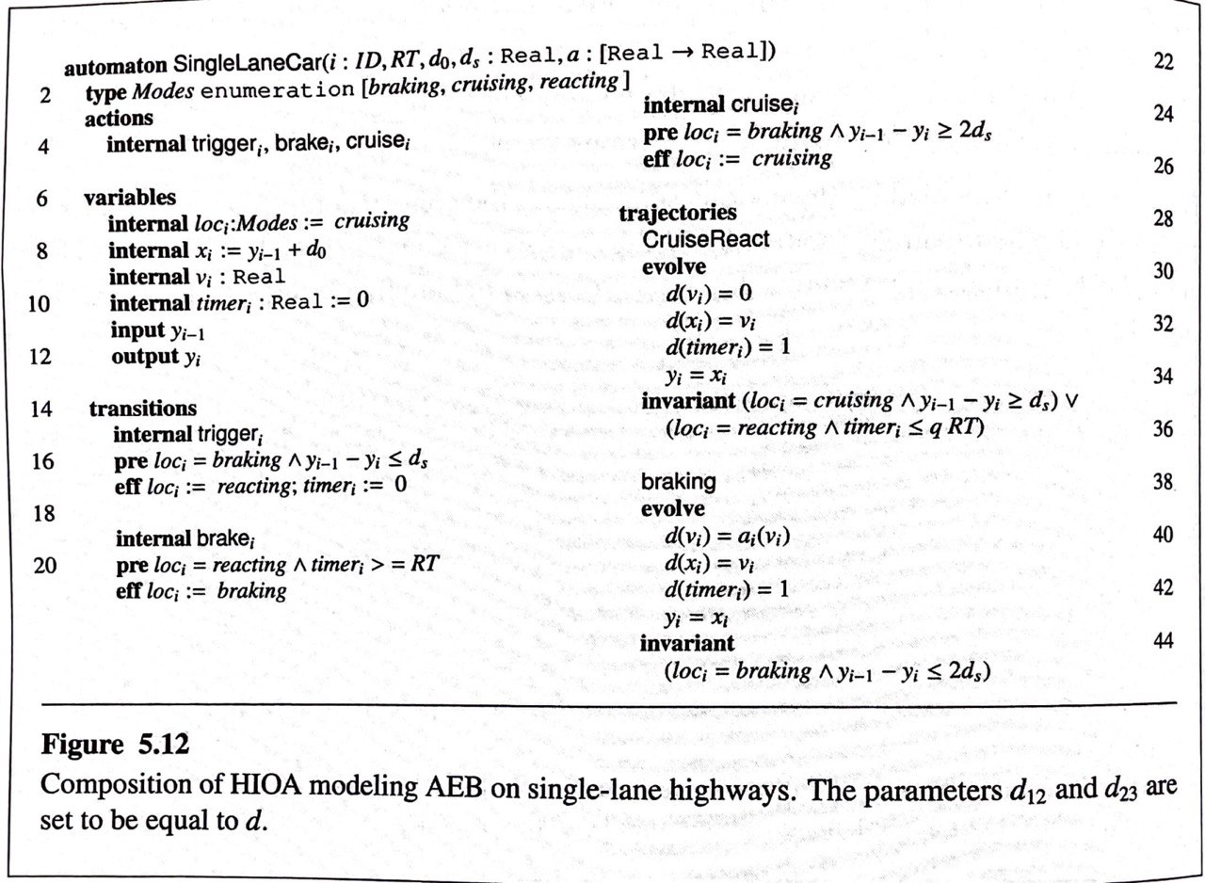
Small aircraft traffic management system

Slide 20
Thank you!!!

